Slide 1


Colombia
Moving Forward
BRC Global Standard for Food Safety
John Kukoly

Slide 2

Global Food Safety Initiative

Slide 3


































Currently Using GFSI
Notes:
These are only some of the many companies that are accepting GFSI recognised schemes in their supply chains.

Slide 4

Solution:
Build Confidence in Third Party Certification & Reduce Inefficiency in the Food System
“Once Certified, Accepted Everywhere”

Slide 5
Food Safety Progression
Best Practices
QMS
FSMS
Basic GMP’s
Prerequisites
HACCP
BRC
GFSI
Notes:
Explain what position statements are and where to find them
During the lifetime of a published Standard the BRC technical committee may be asked to either:
review the wording of a clause in the Standard,
Provide an interpretation for a requirement or
Rule on the grading of non-conformity against a clause
Position Statements are binding on the way that the audit and certification process shall be carried out and are an extension of the Standard.

Slide 6









GFSI Options
Schemes: Re-Benchmarking
Schemes: New Benchmarking
&
CHINA HACCP

Slide 7
Progressive Use of GFSI
Enhance export capability
International food service and retail
Domestic retail
Regulatory for domestic production

Slide 8
Why?
The majority of retail and food service companies in Canada and the United States require GFSI certification as a first step to evaluation a supplier
Many international retail and food service companies are mandating GFSI globally
Increasing regulatory requirements for imports

Slide 9
Regulatory Requirements
FDA
  Food Safety Modernization Act
CFIA
  Safe Foods for Canadian Act
  Supplier verification
  Risk based regulatory oversight
  Preparation for regulatory inspections

Slide 10
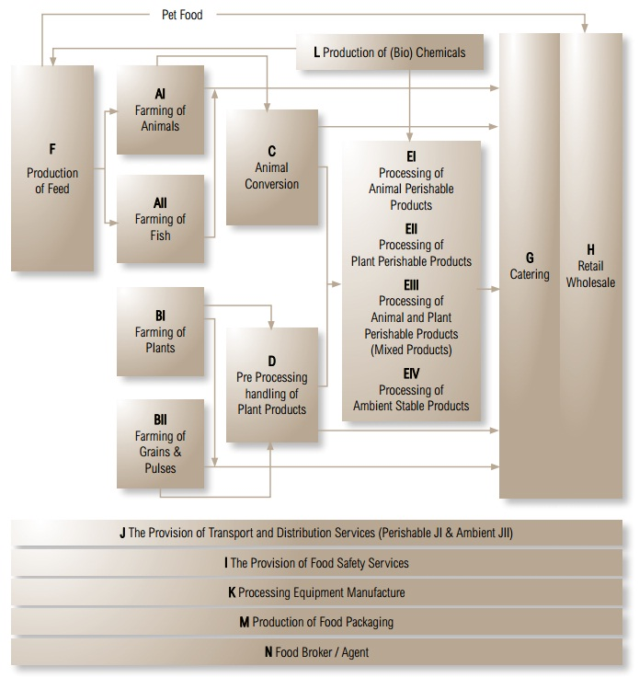
GFSI Food Chain
Scope Expansion to Deliver a Total Supply Chain Approach for Global Companies:
  “Farm to Fork “ approach to cover all sectors of the food system
    Packaging and Animal Conversion: August 2011
    Animal Feed: June 2012
    Storage & Distribution: by mid 2013
    Food Brokers/Agents, Retail/Wholesale: by early 2014
    Catering, Equipment Manufacturing, Food Safety Services: by 2015

Slide 11
The BRC Standards in 2013
Audits conducted in 113 countries
Over 16,000 food sites
Packaging and Logistics, plus…
Across all major regions
Spread of categories in each region
All data collected on the BRC Global Standards Directory

Slide 12
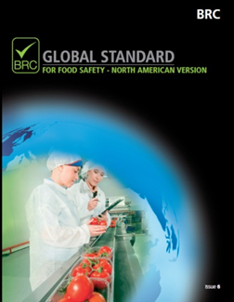
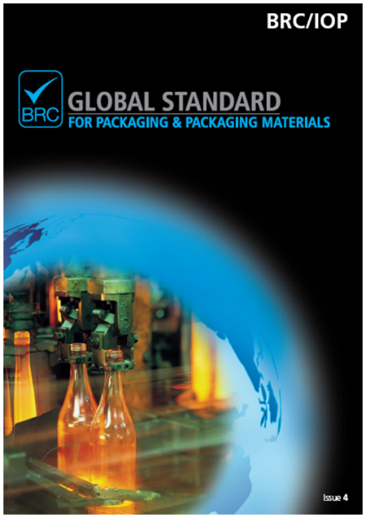


The BRC Standards

Slide 13
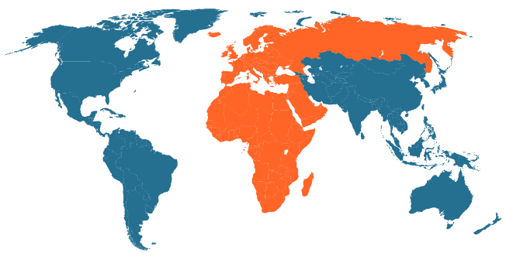
Global distribution
Americas:
EMEA:
Country | % of total sites
UNITED KINGDOM | 15.9
ITALY | 11.0
UNITED STATES | 8.8
SPAIN | 7.4
CHINA | 7.0
NETHERLANDS | 6.4
FRANCE | 4.7
POLAND | 3.2
BELGIUM | 3.1
GERMANY | 2.7
LATIN AMERICA | 2.5
CANADA | 2.3
THAILAND | 2.0
TURKEY | 2.0
IRELAND | 1.8
AUSTRALIA | 1.7
NEW ZEALAND | 1.3
Total | 15592
Asia-Pacific:

Slide 14
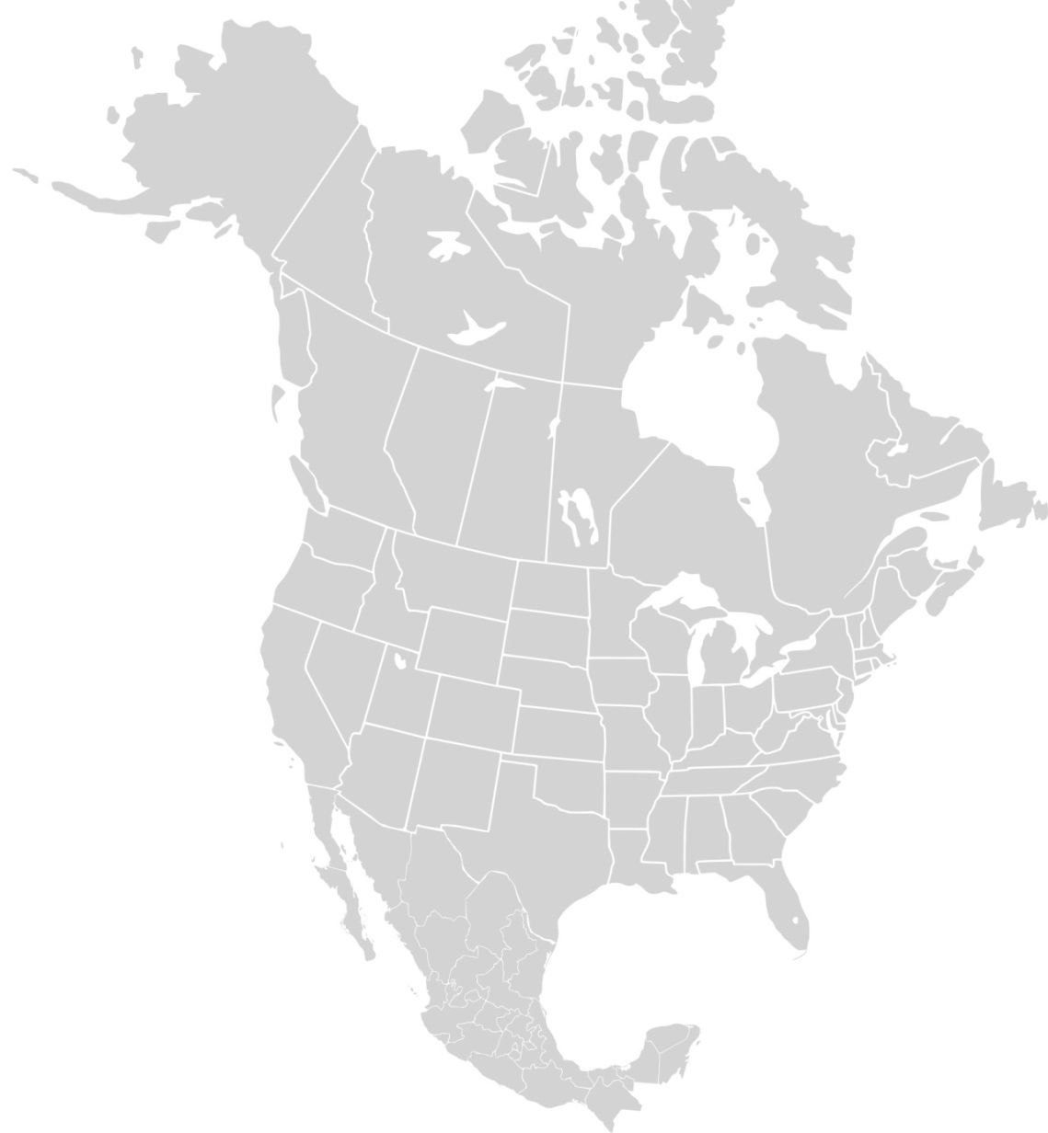
Canada
414 Food
1 Packaging
USA
1491 Food
449 Packaging
29 S&D
7 CP
Mexico
75 Food
3 Packaging
Notes:
Mexico is 1/3 the population of the US, Canada is 1/10.

Slide 15
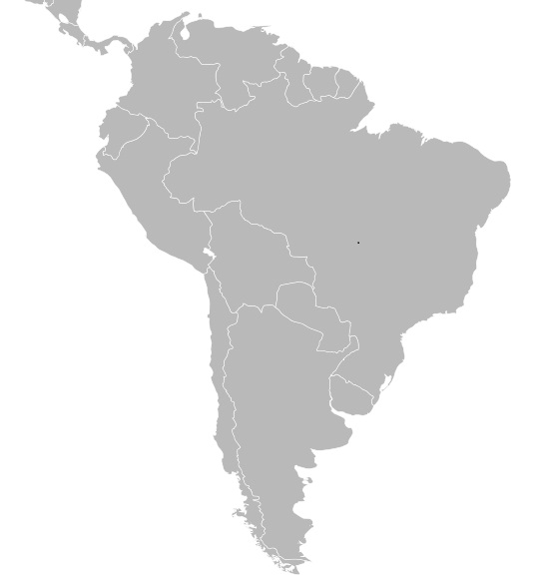
Colombia
10 Food
Ecuador
18 Food
Brazil
88 Food
Packaging
S&D
Peru
71 Food
Chile
167 Food
Packaging
Uruguay
25 Food
Argentina
68 Food
Packaging
12 other countries
41 Food
Packaging
S&D
Notes:
Regional, recently announced mandates for in-country supply expected to be a significant driver in the next few years.

Slide 16
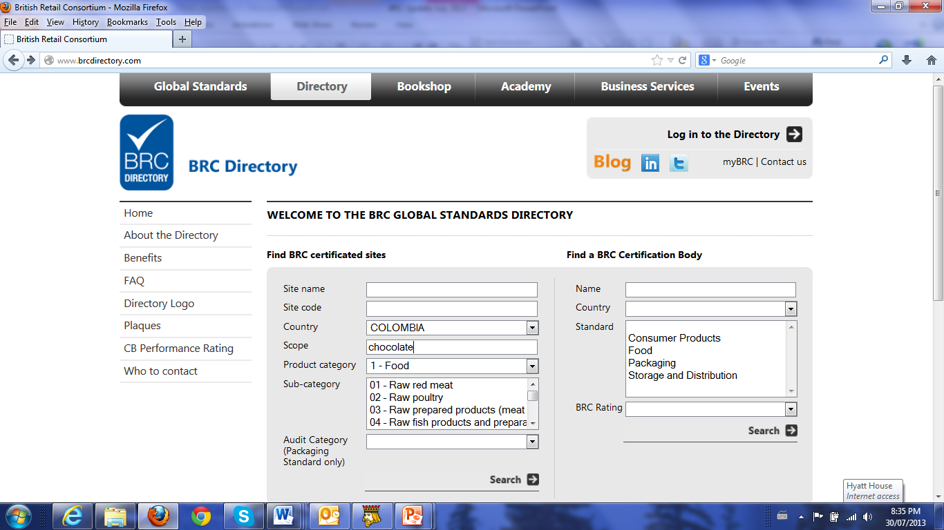
www.brcdirectory.com
Notes:
Mexico is 1/3 the population of the US, Canada is 1/10.

Slide 17
Certification Process
Obtain the requirements
Gap assessment
Implementation
Training
Certification
Maintenance
6 to 18 months

Slide 18
Focus Areas
Supplier and raw material controls
Foreign body control
Housekeeping and hygiene
Allergen management
Provenance/Assurance claims

Slide 19




Relative Non-Conformities
NC groups | Ranking
 | All Sites
(2) HACCP | 1
(4.4) Building Fabric | 2
(4.13) Pest Control | 3
(4.11) Housekeeping and hygiene | 4
(1) Management commitment | 5
(4.7) Maintenance | 6
(4.8) Staff facilities | 7
(3.9) Traceability | 8
(3.4) Internal audit | 9
(4.9.3)Glass, plastics and ceramics | 10
US | UK | LATAM | China
1 | 1 | 1 | 1
2 | 3 | 4 | 2
6 | 5 | 9 | 3
3 | 2 | 3 | 5
7 | 4 | 2 | 4
5 | 7 | 12 | 10
10 | 8 | 6 | 8
11 | 12 | 11 | 6
4 | 6 | 5 | 22
12 | 11 | 14 | 7

Slide 20
Capacity in Colombia
BRC has translated the Standard to Spanish
BRC in process of developing training in Spanish
BRC will develop resources in Colombia
  Trainers
  Auditors
  Consultants

Slide 21
Capacity in Colombia
BRC will ensure certification bodies provide resources in Colombia
Certification body group to be formed in Colombia in 2013 to match demand
Potential for a training and information conference in Colombia sponsored by BRC and certification bodies

Slide 22


www.brcglobalstandards.com
John.kukoly@brcglobalstandards.com

